Slide 1
ME-104L Engineering DRAWING & CAD LAB
Lecture:
Drawing Instruments & Types of lines, lettering
Lecture By: Abid Hussain
Mechanical Engineering Department,
UET Peshawar.
Email: abidhussain@uetpeshawar.edu.pk

Slide 2
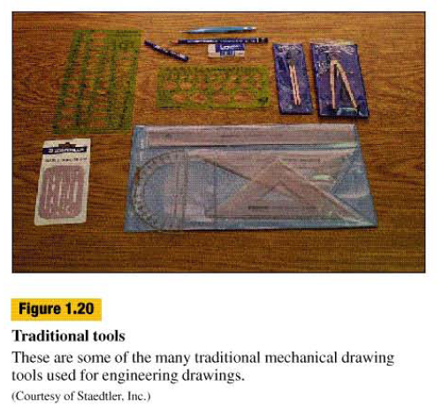
Instruments
In order to create a manual engineering drawings various instrument are used.
They are….

Slide 3
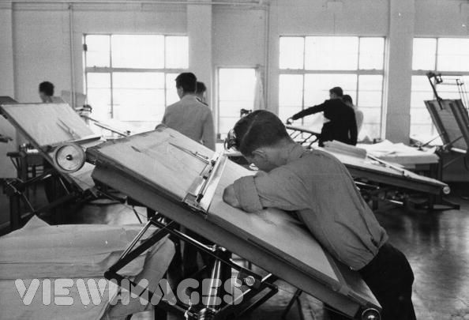
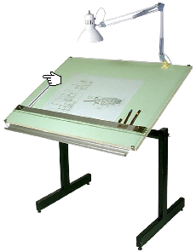
Drawing Boards
Size:
1000(mm) x 1500(mm)

Slide 4
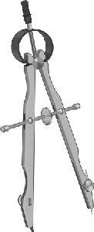
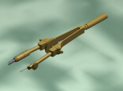
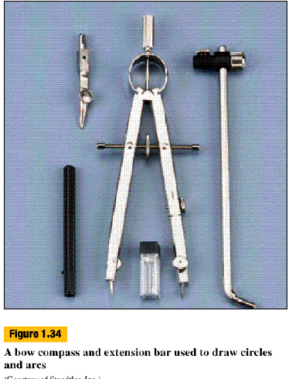
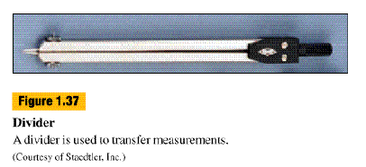
Compass
The compass is used to draw circles and arcs of varying diameters.

Slide 5
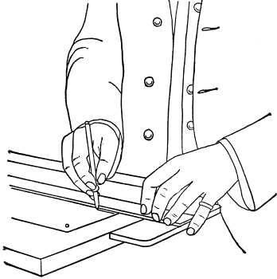
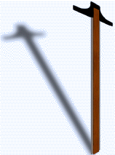
T-Square
T-Square is used for drawing parallel horizontal lines and also as a base for set squares, for drawing vertical, inclined or mutually parallel lines.
The stock of the T-square moves over the working edge of the drawing board.
The working edge of the blade should be perfectly straight.
Blade
Stock
Drawing Edge

Slide 6
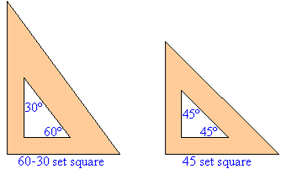
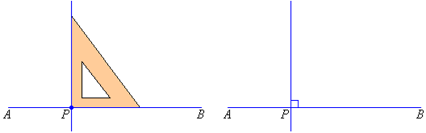
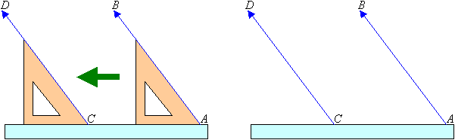
Set Squares
A set square or triangle is an object used in technical drawing (perfect and detail drawing), with the aim of providing a straight edge at a particular point to a baseline.
The most simple form of set square is a triangular piece of transparent plastic.
Drawing perpendicular lines.
Drawing parallel lines.

Slide 7
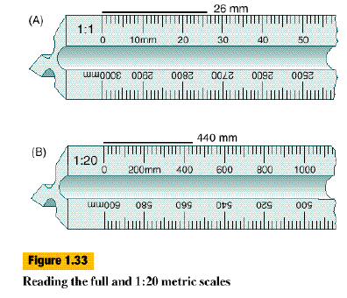
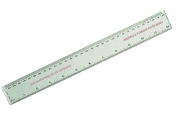
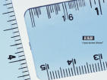
Scales (Ruler)
The international organization that established the metric standard is ISO. The system is called the International System of Units.
Mostly use millimeter scale
Conversion (Inch to mm)
1” (1 inch) = 25.4 mm
inch
mm

Slide 8
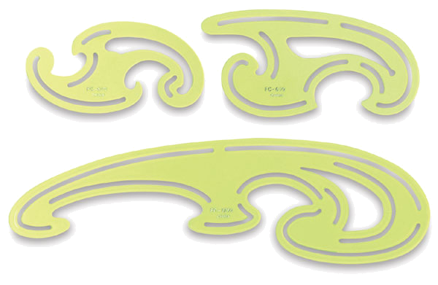
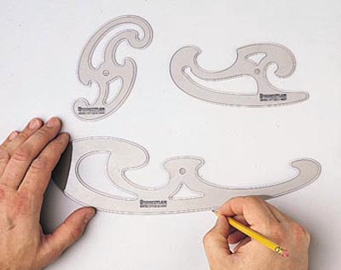
French Curves
They are made mostly of plastic and come in various shapes.
French curves are used for drawing curves which cannot be drawn with a compass.
The curves should be drawn with a single stroke, so that no corners are formed.
They are used for drawing many non-circular curves on graphic charts and for plotting motion, forces and engineering graphs.

Slide 9
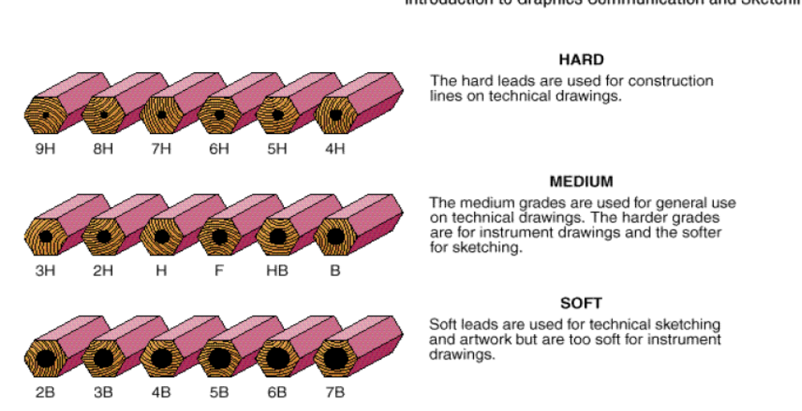
Pencils
The following will be used in labs..
1 H 2 H HB

Slide 10
Drawing Sheet Sizes
Drawing Sheet Size | Size in mm | Size in inches
A0 | 1189 x 841 | 46.81 x 33.11
A1 | 841 x 591 | 33.11 x 23.39
A2 | 594 x 420 | 23.39 x 16.55
A3 | 420 x 297 | 16.55 x 11.69
A4 | 297 x 210 | 11.69 x 8.27
A5 | 210 x 148 | 8.27 x 5.84
A6 | 148 x 105 | 5.84 x 4.13

Slide 11
Common Line Types
Visible Lines: Represent the outline of the object. Continuous thick lines.
Hidden Lines: Used to show the hidden part of the drawings.
Center Lines: Used to indicate the axes of cylinder, cone etc.
Phantom Lines: Used to indicate an alternate position of a moving component.
2mm 1mm

Slide 12
Common Line Types (Contd…)
Cross Section Lines: Used to show the edges of a cutting plane.
Dimension Lines: Thin continuous lines. Terminate with an arrow head.
Extension Lines: Are continuous lines used in dimension lines. A gap of about should be maintain these lines and the visible lines of an object.
Dimensions (mm or inch)

Slide 13
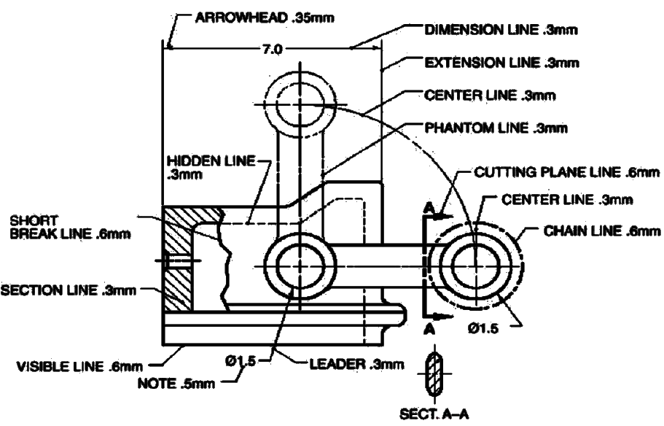
Types of Lines

Slide 14
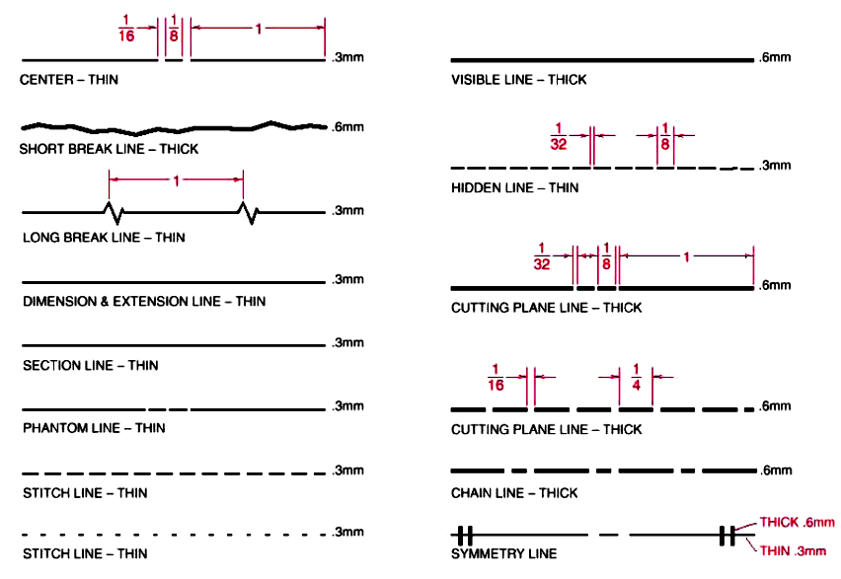
Types of Lines…

Slide 15
Sketching Techniques

Slide 16
Engineering Drawing Rules
Always use a sharp edge pencil.
Make all lettering the same size.
Use engineering paper (A3, A2 etc)

Slide 17
Freehand Technical Lettering
Single stroke letters
General Proportions of letters
  No fix standards for proportions of standards
  It should be such that it looks pleasant to eyes
LETTERS (Normal)
Proportions
LETTERS (compressed)
LETTERS (Extended)

Slide 18
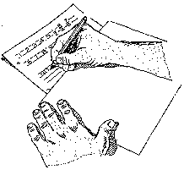
Pencil Techniques
The best pencil for lettering on most surfaces are the 1H, 2H, and HB grades.
Hold your pencil in the position shown. It should make approximately a 60º angle with the paper.

Slide 19
Lettering
The style of engineering lettering we will use in the lab is Single Stroke Gothic Lettering
  An example of the characters is shown on next slide
  Notice that only capital letters are demonstrated, since we will use only capital letters on drawings

Slide 20
Title Box
Name: A B C
Reg #: 2009XXX
Title : …………………
Date : 19 JAN 2016
8
8
8
8
100
Note: All dimensions are in mm.

